Slide 1
Types of Variation for Regression Model
Muhammad Amjad
Assistant Professor at FAST-NUCES

Slide 2

Example # 01
Consider the following hypothetical data.
Construct regression model.

Slide 3
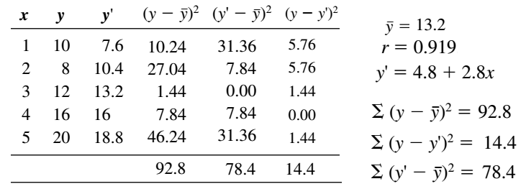
Example # 01 (Contd.)

Slide 4
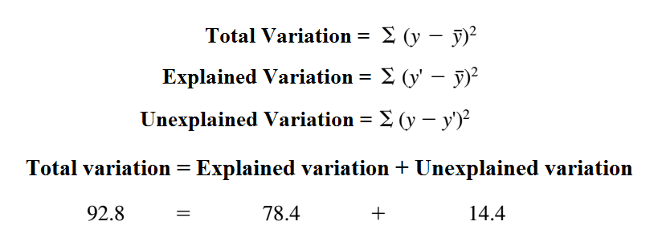
Decomposition of Total Variation

Slide 5
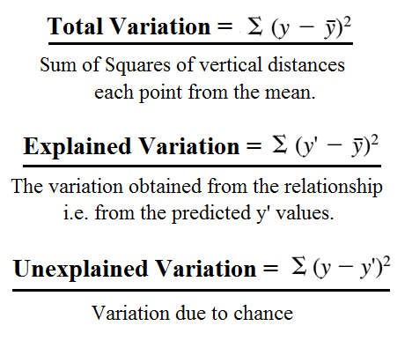
Total Variation (Contd.)

Slide 6
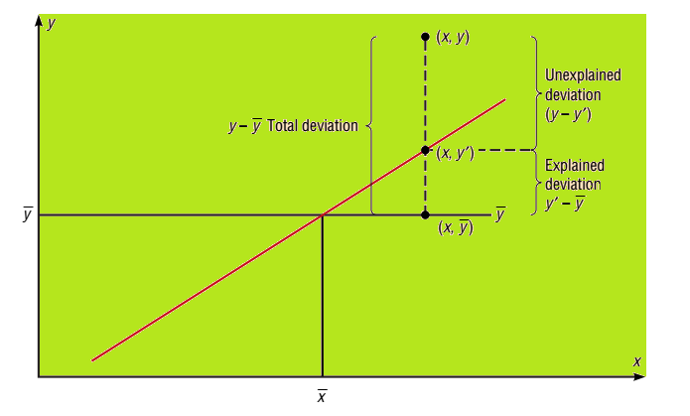
Deviation for the regression eq.

Slide 7
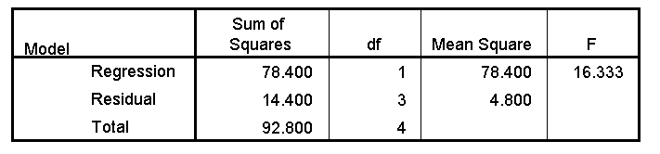
ANOVA approach

Slide 8





Test of Linearity for Regression Coeff.

Slide 9
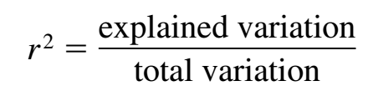
Coefficient of Determination (r²)
The coefficient of determination is the ratio of the explained variation to the total variation and is denoted by r².
For the previous e.g.: r² = 78.4 / 98.8 = 0.845 or 84.5%.
Another way to arrive at the value for r² is to square the correlation coefficient: r = 0.919, and r² = 0.845.

Slide 10
r² (Contd.)
The r² is a measure of variation of the dependent variable that is explained by the regression line and the independent variable.
Therefore, if r² = 0.845 or 84.5% then this result means that 84.5% of the variation in the dependent variable is accounted for by the variations in the independent variable. The rest of the variation, 15.5%, is unexplained.

Slide 11
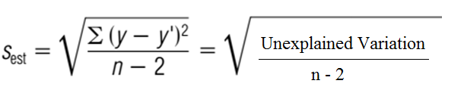
Standard Error of the Estimate
The standard error (SE) of the estimate, is the standard deviation of the observed y values about the predicted y’ values. The formula is:
The closer the observed values are to the predicted values, the smaller the standard error of estimate will be.

Slide 12
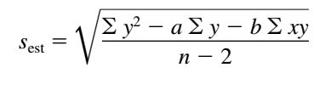
SE (Contd.)
The standard error of the estimate can also be find by using the formula:

Slide 13
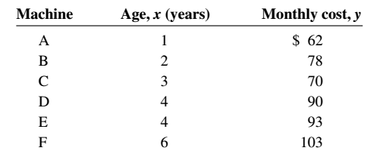
Example # 02
A researcher collects the following data and determines that there is a significant relationship between the age of a copy machine and its monthly maintenance cost. Find the regression eq. and the standard error of the estimate.

Slide 14
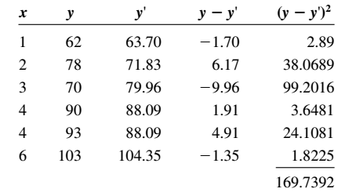


Example # 02 (Contd.)

Slide 15
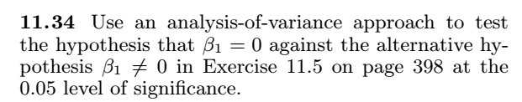
Practice Questions

Slide 16
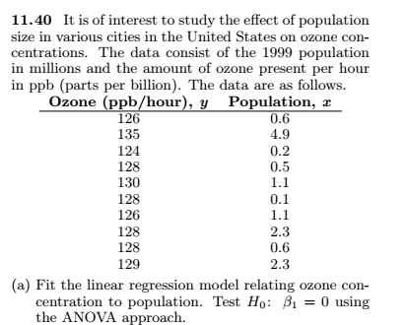
Practice Question (Contd.)

